Slide 1

iBuildPC
By – Aayush Sharma 211193
Aganay Sambyal 211175
Vaibhav Gupta 211183
Opengl, GLFW, FreeType, Vulkan API,GLUT
Used:

Slide 2
01
INTRODUCTION
CONTENTS
02
FLOW CHART
03
PROPOSED SYSTEM
04
SYSTEM DESIGN
05
IMPLEMENTATION

Slide 3
CONTENTS
06
RESULT
07
Future Enhancement
08
CONCLUSION
09
REFERENCES

Slide 4
INTRODUCTION
Computer has become a powerful tool for the rapid and economical production of pictures.
Computer Graphics remains one the most exciting and rapidly growing fields. Old Chinese saying
“One picture is worth of thousand words” can be modified in this computer era into “One picture is
worth of many kilobytes of data”. It is natural to expect that graphical communication will often be
more convenient when computers are utilized for this purpose. Many people for different domain of
applications use interactive graphics. There is virtually no area in which graphical displays cannot be
used to some advantage, and so it is not surprising to find the use of computer graphics so widespread.
Today, we find Computer Graphics used routinely in such diverse areas such as science, engineering,
medicine, business, industry, government, art, entertainment, advertising, education, training, etc.

Slide 5
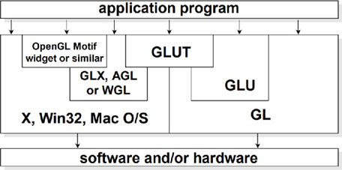
CONTINUED
Computer graphics are the representation of image data by a computer specifically with help from
specialized graphic hardware and software. Computer graphics is creation, manipulation and storage
of geometric objects (modelling) and their images (Rendering) shown in Figure 1.1
Like/Dislike Videos
Users must be able to Like or Dislike the videos
Watch History
Users must be able to check the watch history
Watch Videos
Users must be able to watch videos in the system when they log in or logout.
Figure 1.1 : OpenGL and Related APIs
OpenGL (Open Graphics Library) is a cross-platform, hardware-accelerated, language-independent, industrial standard API for producing 3D (including 2D) graphics. Modern computers have dedicated GPU (Graphics Processing Unit) with its own memory to speed up graphics rendering. OpenGL is the software interface to graphics hardware. OpenGL graphic rendering commands issued by your applications could be directed to the graphic hardware and accelerated

Slide 6
LIBRARIES
01
Core OpenGL (GL)
02
OpenGL Utility Library
03
OpenGL Utilites Toolkit
1). Core OpenGL (GL): Creation of models using set of geometric primitives such as points, line and polygon.
2) OpenGL Utility Library (GLU): This library is built on top of Core OpenGL to provide important utilities ( such as setting camera view and projection ) and more building models.
3). OpenGL Utilites Toolkit (GLUT): OpenGL is designed to be independent of windowing system or Operating System.

Slide 7
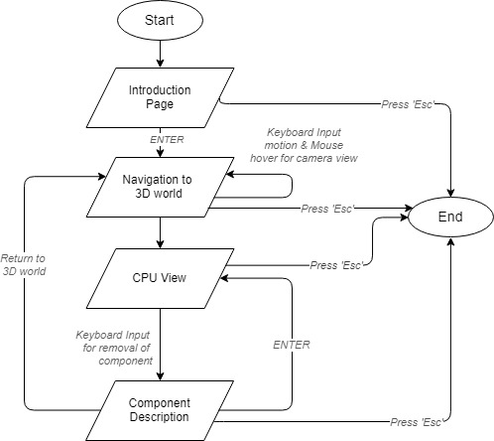
02 . Flow Chart
Flowchart is a graphical representation of a computer program in relation to its sequence of functions. The flowchart shows the steps as boxes of various kinds, and their order by connecting the boxes with arrows. Flowcharts are used in analyzing, designing, documenting or managing a process or program in various fields.
Like/Dislike Videos
Users must be able to Like or Dislike the videos
Watch History
Users must be able to check the watch history
Watch Videos
Users must be able to watch videos in the system when they log in or logout.
Figure 5.3 : Flow Chart of System - overall flow of system

Slide 8
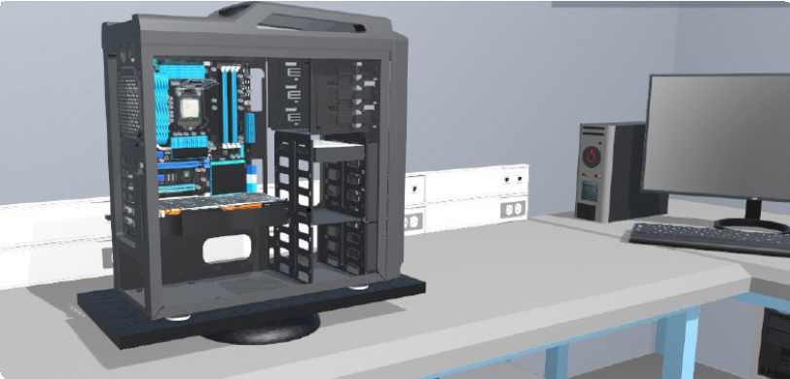
03 . PROPOSED SYSTEM
This proposed system simulates the components of a desktop with which user can interact through some
interface and information about the component. Thus, Proposed system contains of 3 modules - Object
Module, Input Module, Text Module and Transformation Module
Upload & Delete
Personal Account
3.1. Object Module : Current System consists of a CPU Cabinet which accommodates smaller components like
Motherboard, CPU, GPU, PSU, Head Sink, Cooling Fan, RAM Stick(s), Hard disk drive or and SSD etc
Users must be able to upload/delete videos in the system when they log in.
Users must be able to create a personal account.
Own Personal account page
Each registered user must have their own personal account page.
Login and logout
Users must be able to log in to the system and logout from the system.
Create Channels
Figure 3.1: Object Module - CPU Cabinet consisting of all the components intact
Users must be able to create channels.

Slide 9
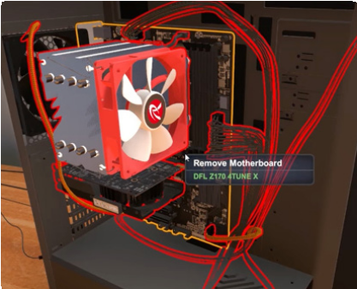
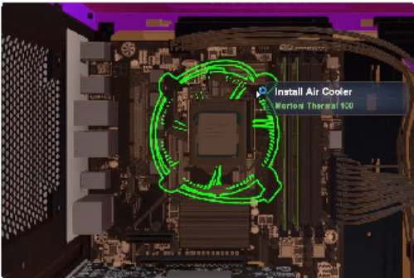
CONTINUED
3.1. Input Module : This module defines the acceptable and valid user interactions
Like/Dislike Videos
Users must be able to Like or Dislike the videos
Watch History
Users must be able to check the watch history
Figure 3.2
Figure 3.3
Watch Videos
Users must be able to watch videos in the system when they log in or logout.
Figure 3.2 : Mother Board and sub parts are selected through the mouse input.
Figure 3.3 : CPU Cooler is select through mouse click (input)

Slide 10
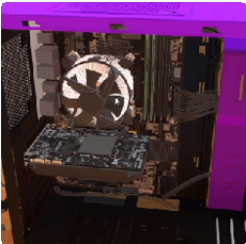
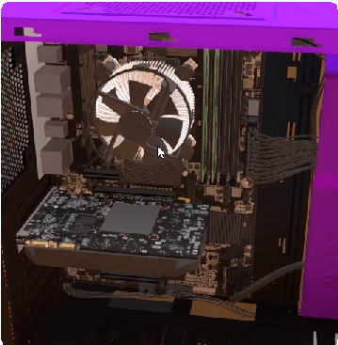
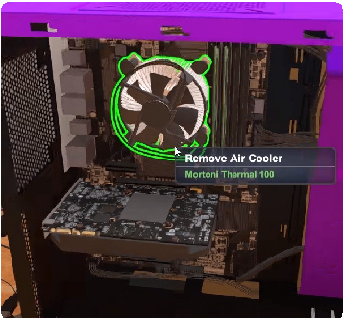
CONTINUED
3.3. Transformation Module : Transformation module changes the view from generic to specific components of the desktop. The transformation occurs due to the action specified by the Input Module
Like/Dislike Videos
Users must be able to Like or Dislike the videos
Watch History
Users must be able to check the watch history
Figure 3.4
Figure 3.5
Figure 3.6
Watch Videos
Users must be able to watch videos in the system when they log in or logout.
Figure 3.4, 3.5 and 3.6 : Represents the transformation of CPU Cooler, which it will be fitted on top of CPU. The transition is shown in small amount in the distance from Mother Board to CPU Cooler in serial pictures from left to right

Slide 11
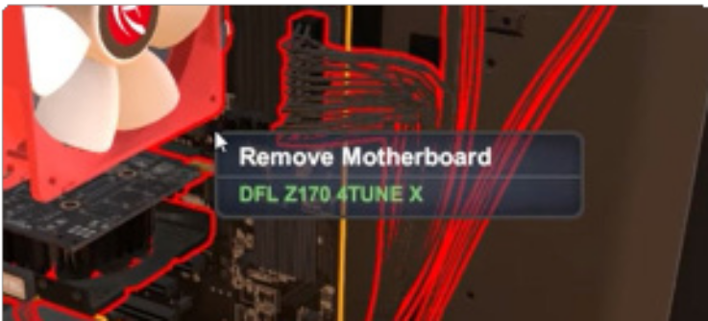
CONTINUED
3.4. Text Module : Text module annotates information based on the action specified by the Input Module. It provides details about specific interacted components of the desktop.
Like/Dislike Videos
Users must be able to Like or Dislike the videos
Watch History
Users must be able to check the watch history
Watch Videos
Figure 3.7
Users must be able to watch videos in the system when they log in or logout.
Figure 3.7 : Text Module - Represents the text based
information over the window to give information about the system.

Slide 12
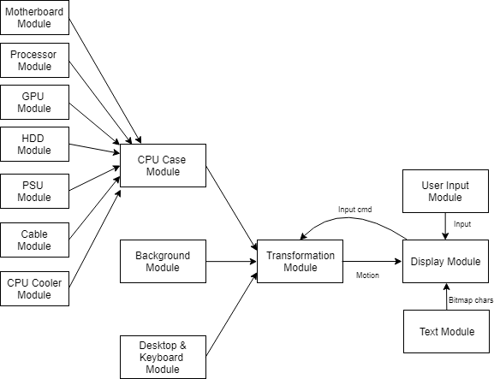
04 . SYSTEM DESIGN
The modular design will describe the various components used in this project. Figure 5.1 it shows the different modules present in the proposed graphical project.
Like/Dislike Videos
Users must be able to Like or Dislike the videos
Watch History
Users must be able to check the watch history
Watch Videos
Users must be able to watch videos in the system when they log in or logout.
Figure 5.1 : Modular Design - Construction of system
OpenGL (Open Graphics Library) is a cross-platform, hardware-accelerated, language-independent, industrial standard API for producing 3D (including 2D) graphics. Modern computers have dedicated GPU (Graphics Processing Unit) with its own memory to speed up graphics rendering. OpenGL is the software interface to graphics hardware. OpenGL graphic rendering commands issued by your applications could be directed to the graphic hardware and accelerated

Slide 13
CONTINUED
5.1 CPU Case Module: This module consists of various sub-modules of the CPU module.
5.2 Background Module : This module contains various background objects to complete the picture of background. This module contains the structure of the house, sofa, table, desk etc.
5.3 Desktop & Keyboard Module : This module contains the desktop and keyboard structure of the computer.
5.4 Transformation Module : Transformation module performs the various types of transformation on the components
5.5 Display Module : This module produces the frame of the current scene under transformation. This module is supported by the text module which uses Bitmap to produce text to guide the user.
5.6 Input Module : User actions ( Mouse click, Mouse hover, Key press ) is recorded through this module and given to the transformation module for further action and for processing the inputs.
Like/Dislike Videos
Users must be able to Like or Dislike the videos
Watch Videos
Users must be able to watch videos in the system when they log in or logout.

Slide 14
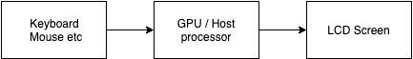
4.2 . Hardware Design
Like/Dislike Videos
Figure 5.2 : Hardware Design
Users must be able to Like or Dislike the videos
Keyboard and Mouse : Keyboard is a device which contains the keys which returns the ASCII value when pressed. According to the user interaction the intended procedure is carried out. Similarly, mouse contains buttons which can obtain user input in the form of a click or hovering and carry out the intended procedure.
GPU / Host Processor : GPU is Graphical Processing Unit which can handle parallel processing like drawing lines, points, polygons better than serial processor ie. CPU. GPU accelerates the creation of image in frame buffer intended for displaying device.
LCD Screen : This contains individual Light Emitting Diode that contains either Red, Green, Blue light colour emitting diodes. These will be illuminated when stream of bytes (usually 32bit) of information comes to the display at 30 to 60 times per second. The diode emits light according to this information.
Watch History
Users must be able to check the watch history
Watch Videos
Users must be able to watch videos in the system when they log in or logout.

Slide 15
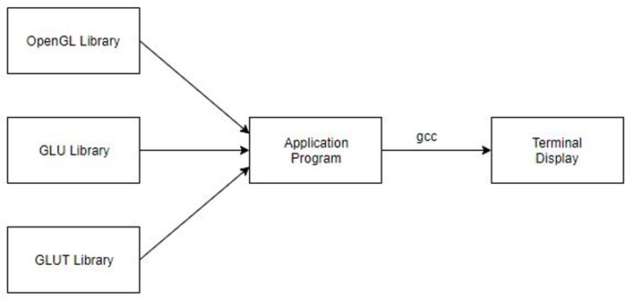
4.3 . Software Design
Like/Dislike Videos
Users must be able to Like or Dislike the videos
Watch History
Figure 5.3 : Software Design
Users must be able to check the watch history
Application Program : Executable is created by compiling and linking several OpenGL libraries. These instructions are loaded into memory which is already in executable format. Therefore the loading time will be less.
Terminal Display : The window which provides the view-port for displaying the scene.
Watch Videos
Users must be able to watch videos in the system when they log in or logout.

Slide 16
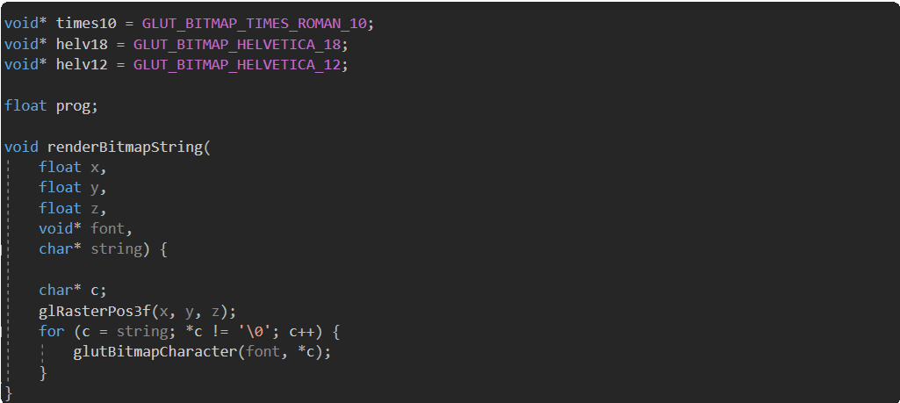
05 . Implementation
Implementation is the core step in software development life cycle. Implementation gives the detailed view of the project and describes the pseudo code and various important functions in the project. It will also give insight about various inbuilt modules and functions in OpenGL.
Like/Dislike Videos
5.1 Code Snippet : Bitmap Loader The text module has been displayed in 3D environment, by the code snippet below. Here each character is encoded to display in view-coordinates.
Users must be able to Like or Dislike the videos
Watch History
Users must be able to check the watch history
Watch Videos
Users must be able to watch videos in the system when they log in or logout.

Slide 17
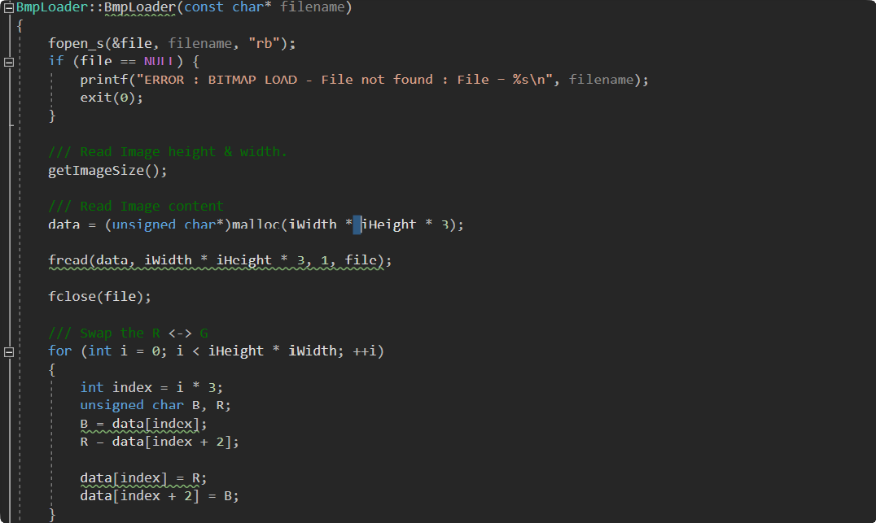
Continued
5.2 Code Snippet : Texture Map Loader
In order to map the bitmap images to onto the 3D objects they must be read in specific way from file. Then using this array we are able to generate textures.
Like/Dislike Videos
Users must be able to Like or Dislike the videos
Watch History
Users must be able to check the watch history
Watch Videos
Users must be able to watch videos in the system when they log in or logout.

Slide 18
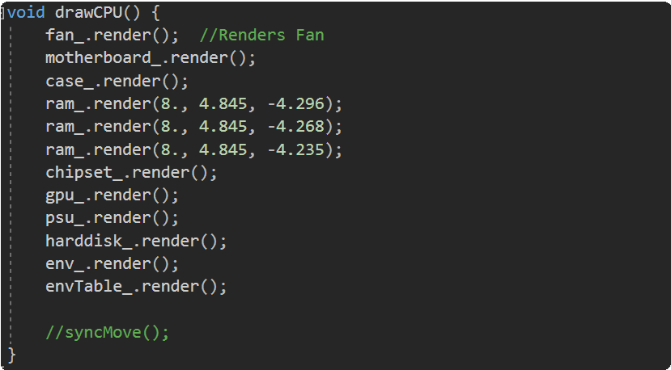
Continued
5.3 Code Snippet : drawCPU To assemble all the complex components defined in each of their class, the drawCPU method is used. Here all the objects are instantiated and the render( ) method of each object is called.
.
Like/Dislike Videos
Users must be able to Like or Dislike the videos
Watch History
Users must be able to check the watch history
Watch Videos
Users must be able to watch videos in the system when they log in or logout.

Slide 19
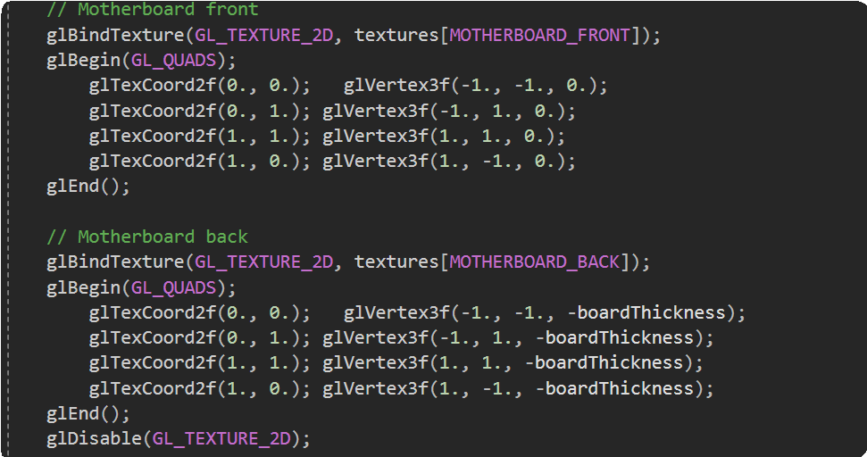
Continued
5.4 Code Snippet : Motherboard Surface Creation + Apply Texture Map
In the code snippet given below, activation of texture mapping & creation of surface and mapping to it’s surface with the required indexed texture is shown. At the end texture mapping is disabled.
.
Like/Dislike Videos
Users must be able to Like or Dislike the videos
Watch History
Users must be able to check the watch history
Watch Videos
Users must be able to watch videos in the system when they log in or logout.

Slide 20
06
RESULT AND SNAPSHOTS

Slide 21
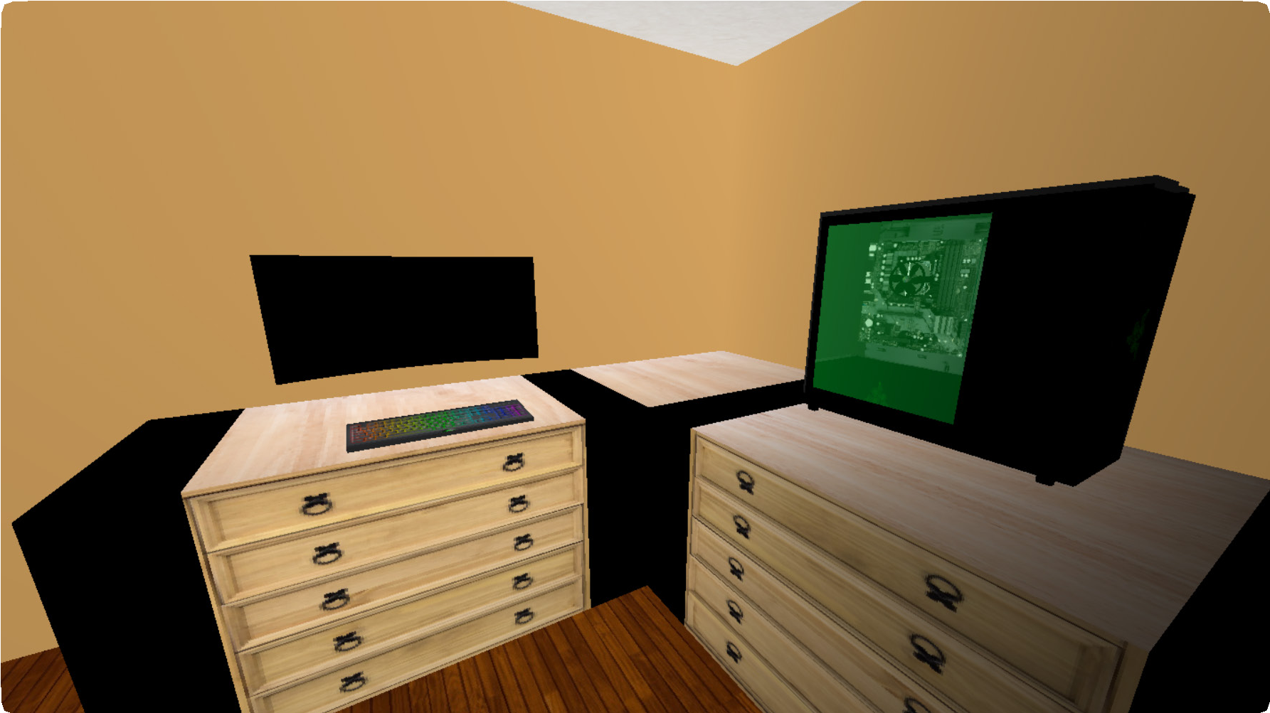
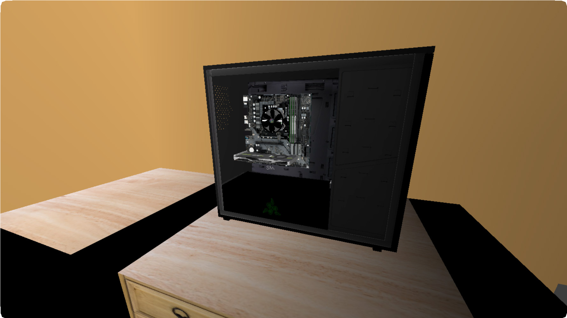
06 . RESULT AND SNAPSHOTS
Desktop View
Figure 7.2 shows the components of a desktop which is supposed to be disassembled.
Figure 7.2 : Desktop View
CPU View
Figure 7.3 shows the CPU’s internal
components intact.
Figure 7.3 : CPU View

Slide 22
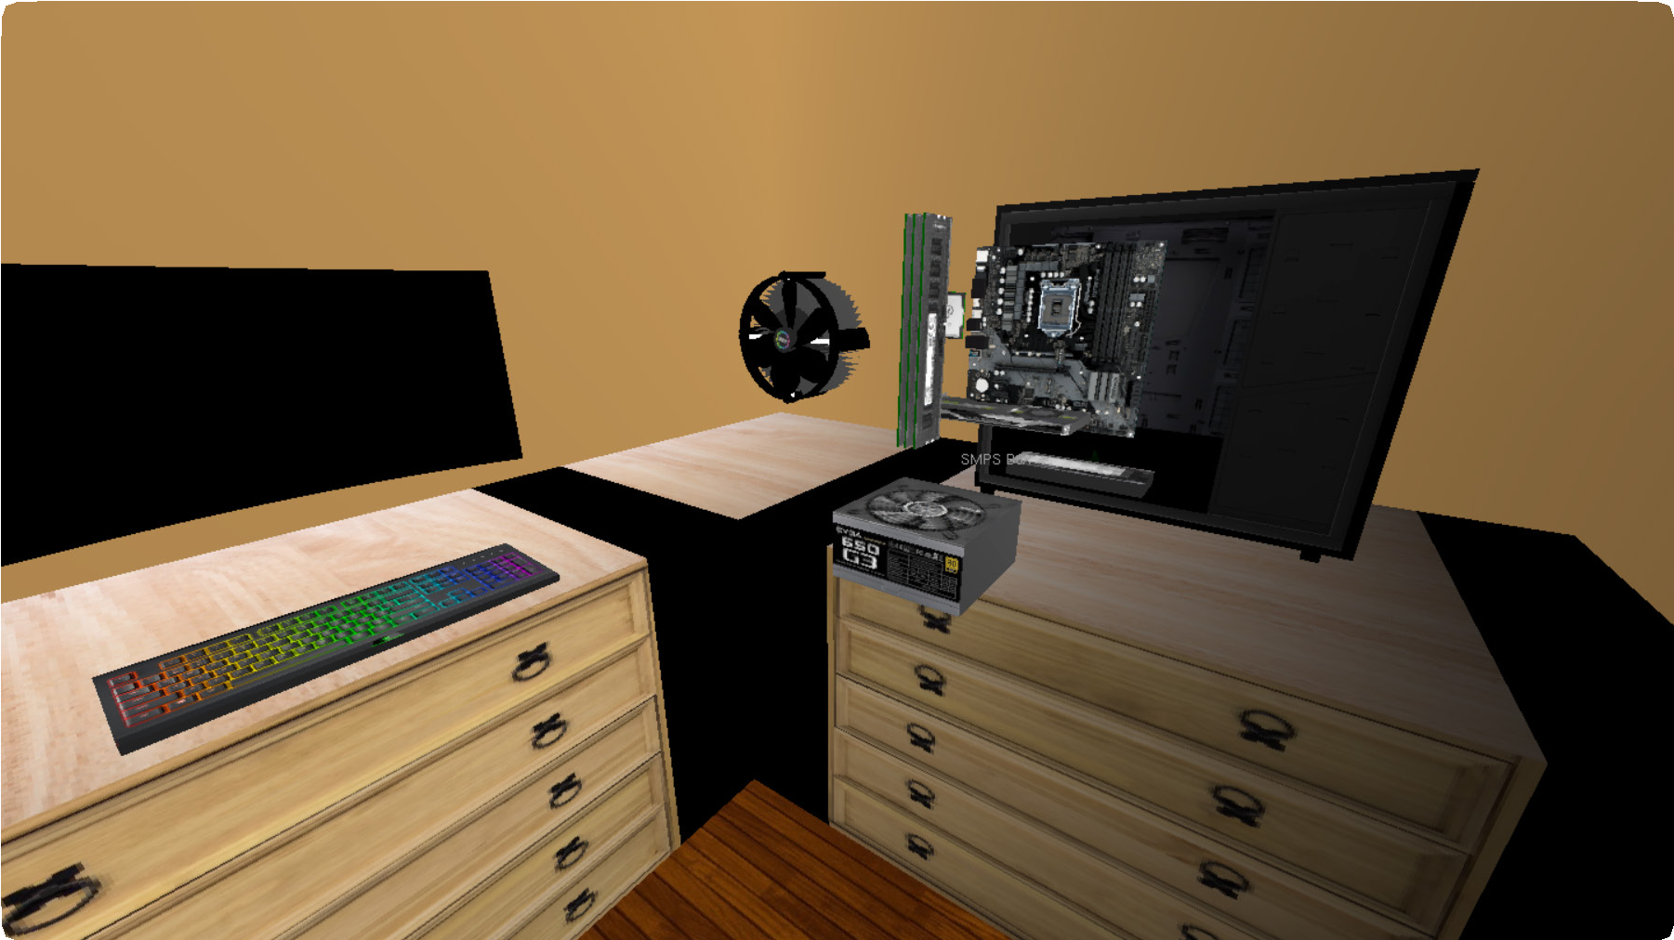
Continued
Disassembled View
Figure 7.4 shows all the components
present in the CPU in detail.
Figure 7.2 : Desktop View
Figure 7.4 : Disassembled View

Slide 23

08 . Future Enhancement
In the future enhancement of the project, the following features can be added :
1. More user-friendly interactions with the components.
2. For each component, different variations can be given
so that the user can choose from it during the assembly
procedure.
3. Each configuration of the assembled desktop
by the user can be Benchmarked.

Slide 24

09 . Conclusion
This project tries to give a complete overview on the various components of the computer. OpenGL provides various functions with which the user interaction is made easier to achieve the aforementioned. Due to the utilization of texture mapping which is a components of OpenGL we can give the user a real life experience of working with a desktop.

Slide 25

10 . References
Web Reference:
Donald Hearn & Pauline Baker: Computer Graphics-OpenGL Version,3rd Edition, Pearson Education,2011
Cuboid Component : https://henry416.wordpress.com/2013/11/09/open-gl-3d-cuboid- transformation-example/
Spherical Component : http://www.songho.ca/opengl/gl_sphere.html
Fan Animation Code : https://vharesh4.wordpress.com/2015/09/09/animation-fan-c-program/

Slide 26
Thank you

